Slide 1
STARTUP PREDICTION
Predicting whether a Startup will be acquired or shut down
Team Number: 14
Team members: Prameya Krishn - Documentation Lead
Veronica Silvery - PPT Lead
Meesala Jyothi Prakash - Video Lead
Rohit Raj - Executive Lead
GitHub Repository: https://github.com/2026dab1301-pKrishn/AI_101_Final_Project_Group-14

Slide 2
PROBLEM STATEMENT & DATASET
THE PROBLEM:
Startups face uncertainty about their future outcomes. Some startups are acquired by other companies, while others shut down.
OUR OBJECTIVE:
To develop a Logistic Regression model that predicts whether a startup will be acquired or closed based on its total funding amount.
DATASET INFORMATION:
Dataset: Startup Investments Analysis
Source: Hugging Face
Original: Crunchbase (via Kaggle)
Records: 4,757 | Columns: 23
Target Variable: Status
1 = Acquired | 0 = Closed
Missing Values: 0
Duplicate Records: 18

Slide 3
PROJECT APPROACH
01
DATASET
Startup data
02
FEATURE
Select funding and status
03
PREPROCESS
Log transform and Scaling
04
MODEL
Logistic
Regression
05
EVALUATION
Test and Predict Outcomes
DATASET → FEATURE SELECTION → PREPROCESSING → MODEL TRAINING → EVALUATION
TECHNOLOGIES USED:
Python | Pandas | NumPy | Matplotlib | Seaborn | Scikit-learn

Slide 4
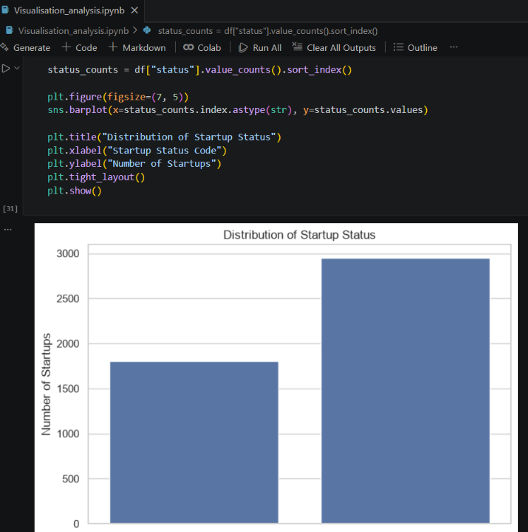
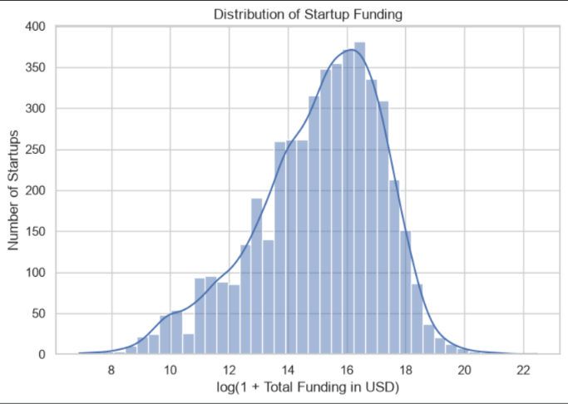
RESULTS & ANALYSIS
Startup Status Distribution
Distribution of Total Startup Funding
MODEL PERFORMANCE:
• Testing Accuracy: 73.95%
• Baseline Accuracy: 61.97%
• 5-Fold CV Mean Accuracy: 72.27%

Slide 5
LEARNINGS & CONCLUSION
WHAT WE LEARNED:
Data visualisation helps us understand patterns in startup data.
Funding distribution is uneven across startups.
Logistic Regression gave us a baseline for predicting startup outcomes
WHAT WORKED:
Pandas helped us inspect and organise the dataset.
Visualisations helped us explore startup status and funding patterns.
Log transformation and Standard Scaling helped prepare funding data for model training.
WHAT DIDN’T:
The Logistic Regression model struggled to identify startups in status class 0.
AI USE DISCLOSURE : AI tools were used for guidance, code assistance, and presentation preparation. The team reviewed and adapted the outputs for the project.
INDIVIDUAL CONTRIBUTIONS:
Rohit Raj : Dataset preparation and
preprocessing
Prameya krishn : Model training
Meesala Jyothi Prakash : Model
evaluation
Veronica Silvery : Visualisation &
Analysis
INDIVIDUAL CONTRIBUTIONS:
Rohit Raj : Dataset preparation and
preprocessing
Prameya krishn : Model training
Meesala Jyothi Prakash : Model
evaluation
Veronica Silvery : Visualisation &
Analysis

